Slide 1

Notes:
New Logo to be added – take green logo, from gmail email that was sent to Daniel

Slide 2
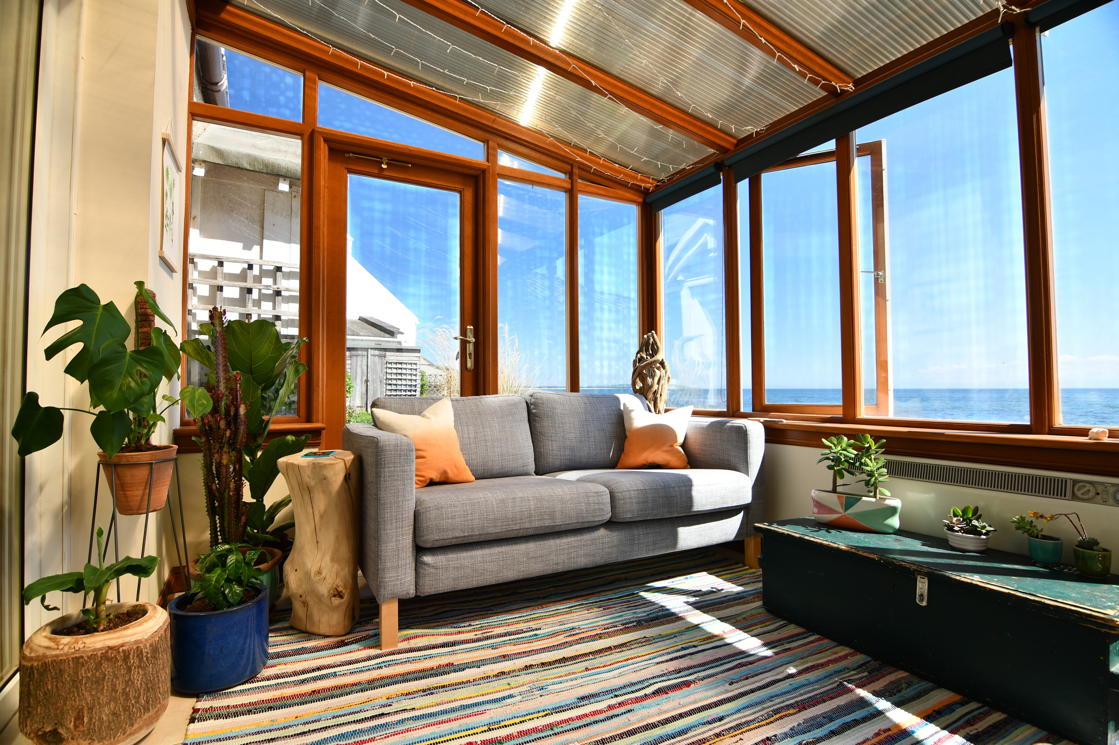
First Page (First page landed on)
Header bar here
Sublee (Logo here)
Subletting, simplified.
Sublee makes getting out of your lease or into a sublet, easy
Whether it’s a new job in a new city, a 6-month back packing trip across the globe, or a new condo you’ve set your sights on – don’t let a contract stop you from life’s journey
Start My Sublet (CTA Button)

Slide 3





How it Works (Second page)
Header bar here
Sublee (Logo here)
Sublee is designed to streamline the subletting process, taking you from apartment search to close within one day
Browse Marketplace of Listings
Connect with Interested Tenants
Get Verified & Approved
Agree to Terms & Sign
Submit Payment and Relax

Slide 4




Current Tenants (Third page)
Header bar here
Sublee (Logo here)
Subletting your apartment shouldn’t be complicated, so we’ve built a product with you in mind
Let us take care of the tough stuff
Apartment lead generation; we’ll make sure people notice your place
Tenant Background Verification; our team will do the homework for you
Customized Lease Contracts; protective over that new paint job? Include the clause in the contract
Payment Handling; worried about organizing payment? We’ll make sure everyone get’s their cake
Post my lease

Slide 5



Sublet Seekers (Fourth page)
Header bar here
Sublee (Logo here)
Stay a while… actually, for however long you want; find the right lease, for the right length of time
Benefits:
Short-term leasing options; find lease options between 2-12 months
Automated rent payments; we’ll ensure the right person gets their cake
Get approved from anywhere; can’t visit the apartment before signing? Don’t worry – if we can vet you, you’re in
Find my sublet

Slide 6
About Us (Fifth page)
Header bar here
Sublee (Logo here)
Sublee is designed to democratize the Canadian leasing process. Let’s face it, long-term commitments like 12 month leases don’t work for everyone. Sublee is here to lift the constraints on year long leases enabling renters to find flexible, short-term, market rate options. Our team is excited to bring Canadians the flexible apartment living you deserve.
Start my sublet

